Slide 1
Social Network Analysis on
Formula 1

Slide 2
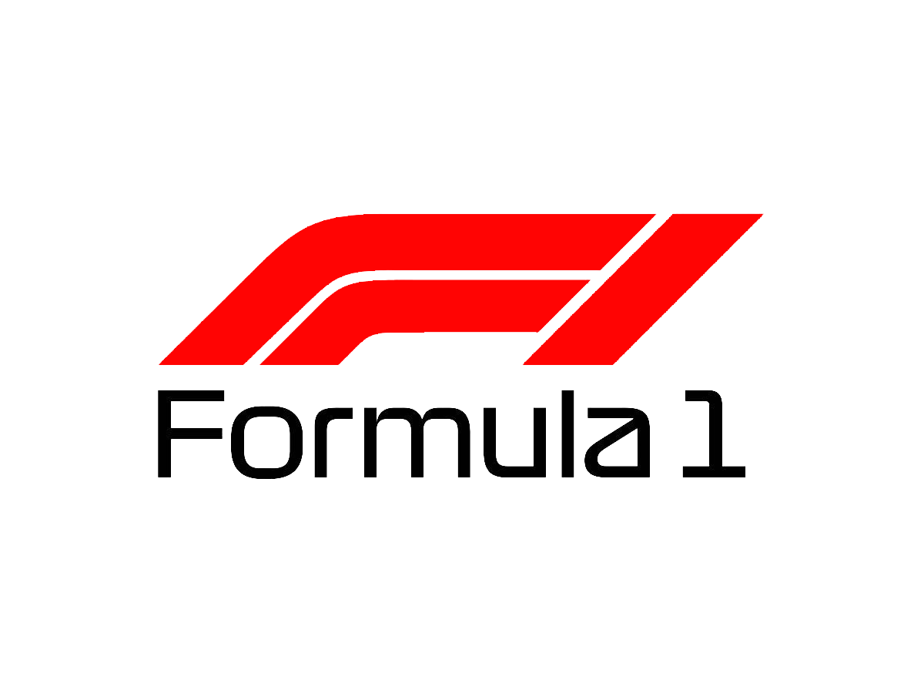
What is Formula 1?
Formula 1 is one of the most popular and technologically advanced sports in the world. It is the pinnacle of motorsport/automobile technology.
It is the biggest and highest degree of international racing for single-seater formula racing cars.
.A Grand Prix race week comprises a practice day, qualifying race day, and final race day. Together all these races are called the F1 season, governed and sanctioned by the Fédération Internationale de l’Automobile (FIA).
In the race, FIA evaluates the performance of the driver and the constructor.
At the end of a season, the FIA combines the scores made by each and awards two annual World Championships: F1 Driver Championship and Constructor Championship.

Slide 3
Why Formula 1?
This generationally established motorsport predominantly taking place in Europe is picking up popularity in other huge markets since its takeover by a US media/entertainment company, Liberty Media.
F1 as an organization in itself has pushed for increasing its presence in potential markets like the US through the introduction of a Netflix series ‘Drive To Survive’ and ever-increasing popularity on social media channels
Teams have accepted this new influx of fans with open-arms and have moved on from ‘closed-door elite racing club’

Slide 4


Common social media platforms used in F1
Instagram
Twitter
TikTok
Reddit
Our focus points for data collection included:
Twitter
Reddit

Slide 5
Data Collection Period:
Hashtags/Threads:
Preliminary Data collected for exploration: Launch Season - February
Data Collected for Analysis: 3rd week of March until 1st week of May
Formula 1
AstonMartinF1

Slide 6
Premise/Objective:
Track changes in opinion/behavior patterns of fans across different social media platforms
Track apparent changes in behaviour/ disappointment of Aston Martin fans across different platforms

Slide 7
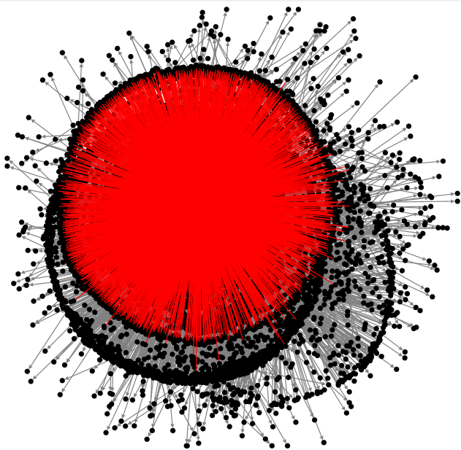
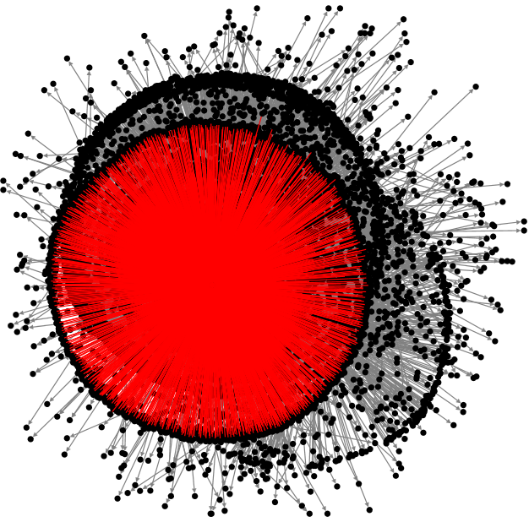
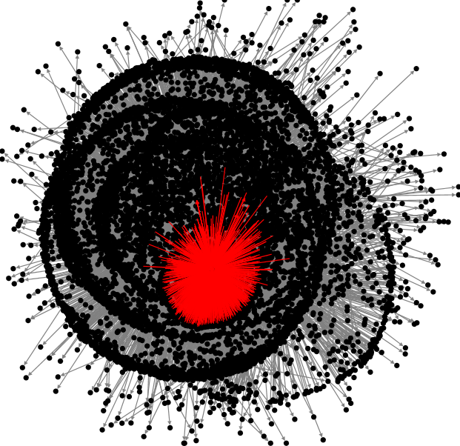
Top 3 Influential Nodes
@vegas
@mgmresorts
@F1
Notes:
Retrieved data from Twitter using NodeXL (Formula1 as search string). In this twitter graph network we identified the official accounts of F1,vegas and mgmresorts as the key actors.

Slide 8
Formula 1 Network Metrics:
Nodes/Accounts | In Degree | Betweenness Centrality | Closeness Centrality
@F1 | 7730 | 69652278.71 | 0.886
@vegas | 3514 | 7391549.99 | 0.595
@mgmresorts | 1012 | 292580.90 | 0.502
Notes:
Other similar influential nodes- @caesarsent (Caesars Entertainment/palace/casino), @wynnlasvegas and other crypto accounts publicising their companies through giveaways
This data is from the Las Vegas Grand Prix 2023 announcement
Again similar points as mentioned below in the Aston Martin section, everything is commercial on twitter

Slide 9
Generalized Metrics Inference:
A few nodes act as initiators of conversations in the network indicated by the relatively low out-degree and high in-degree scores
These nodes set the topic of the conversation and the less influential nodes follow the tone set by these influential nodes through comments, retweets, and mentions
Any ingenious opinions are subdued by the overall tone set
This induces a sort of imaginary restriction of the topic

Slide 10
WordCloud
Word Cloud or Tag Clouds is a visualization technique for texts for visualizing the tags or keywords from the websites.
These keywords are single words that depict the context of the webpage the word cloud is being made from.
Each word in this cloud has a variable font size and color tone which helps to determine words of prominence.
Libraries utilised in Python
Numpy
Pandas
Spacy
Matplotlib
WordCloud
Github code link: https://github.com/itsbhagya95/Social-Network-analytics-project

Slide 11
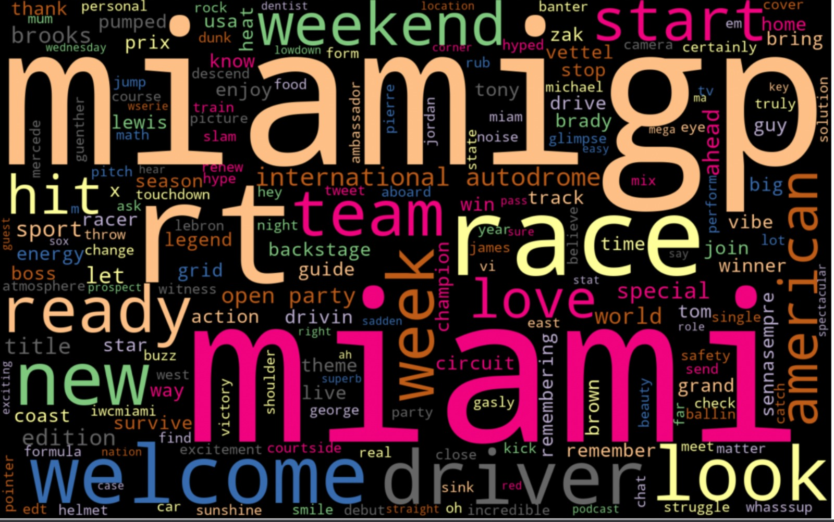
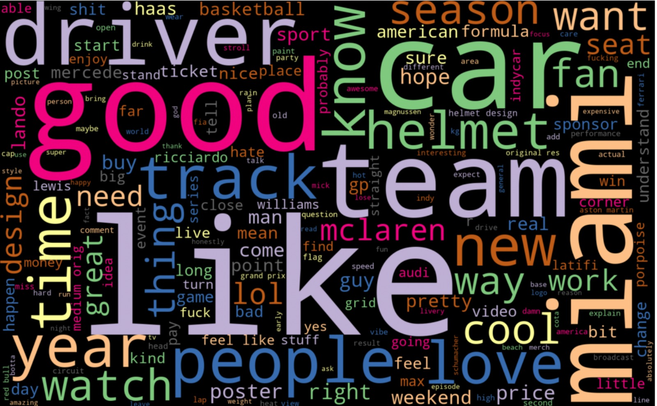
Twitter word-cloud:
Formula 1
Reddit word-cloud:
Notes:
Comparison of the two social media platforms.

Slide 12
Formula 1 word-cloud inference:
Users on Twitter generally talk about the event and the celebrities joining the event, Miami GP, which was a new addition to the 2022 race calendar and a new US race location
Users on Reddit generally talk about the actual race, teams, drivers, cars, and other aspects pertaining to racing rather than commercial aspects of the event

Slide 13
What is N-grams?
N-grams is a sequence of n items from a given sample of text or speech collected from a text or speech corpus.
We have used the following python libraries to implement n-grams:
Pandas
String
Clean
nltk,spacy,wordcloud, ngrams
Github code link: https://github.com/itsbhagya95/Social-Network-analytics-project

Slide 14
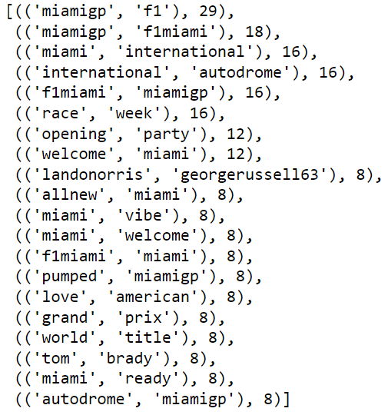
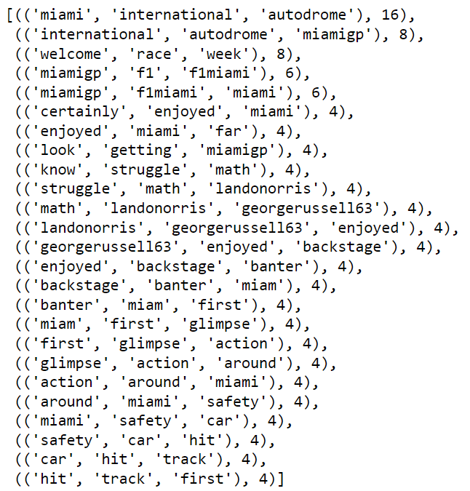
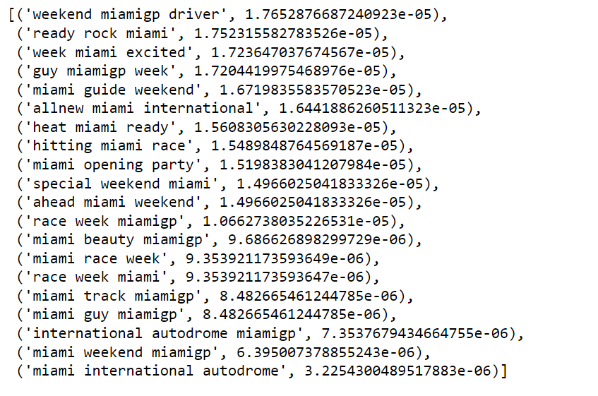
N-grams for Twitter Formula1 data
n=2
n=3
Yake model

Slide 15
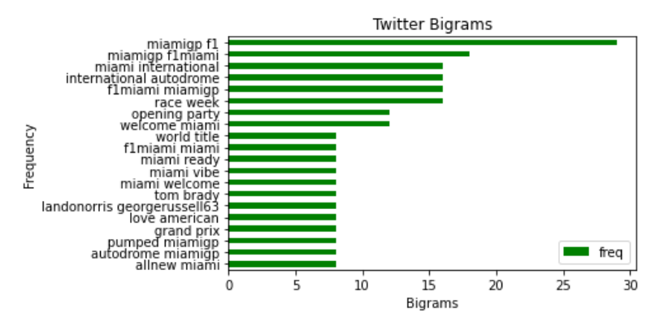
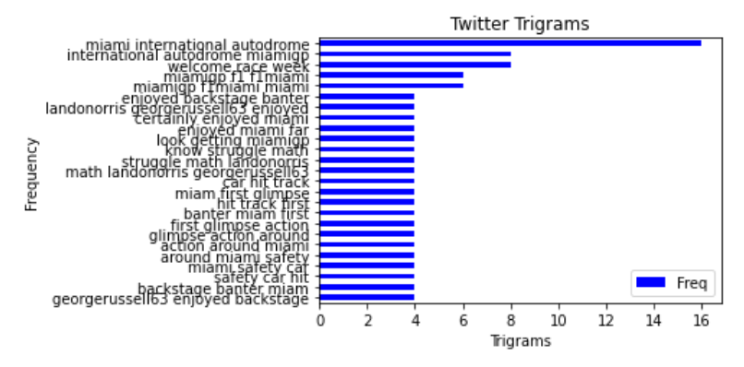
N-grams visualization for twitter
n=2 n=3

Slide 16
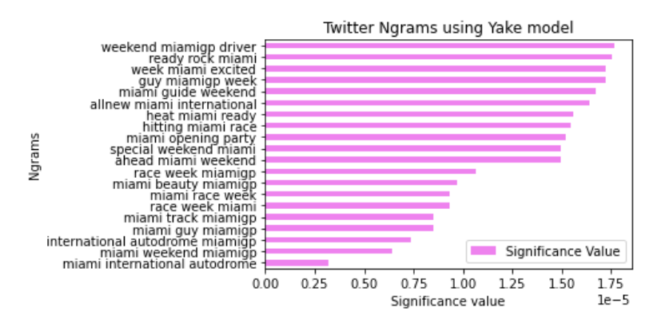
TWITTER N-GRAMS USING YAKE MODEL

Slide 17
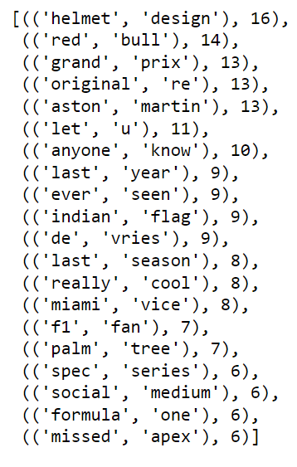
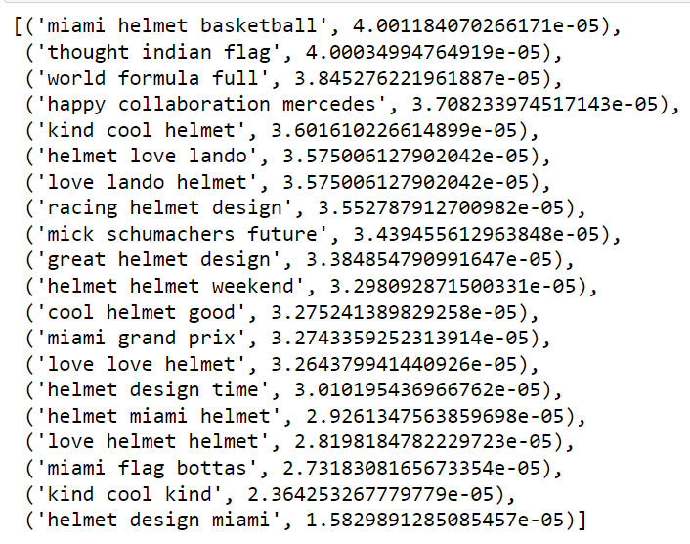
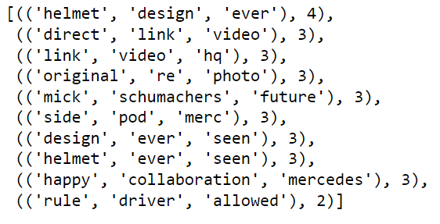
N-grams for Reddit Formula1 data
n=2
n=3
Yake model

Slide 18
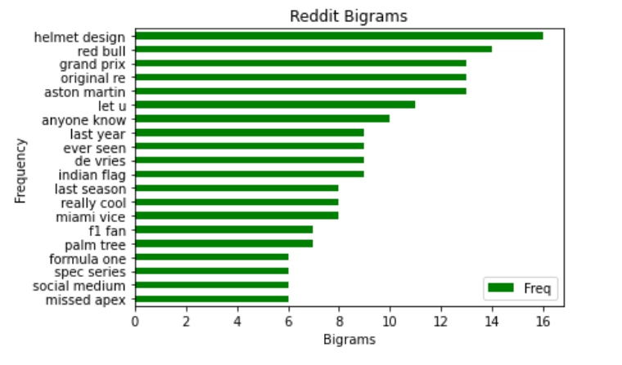
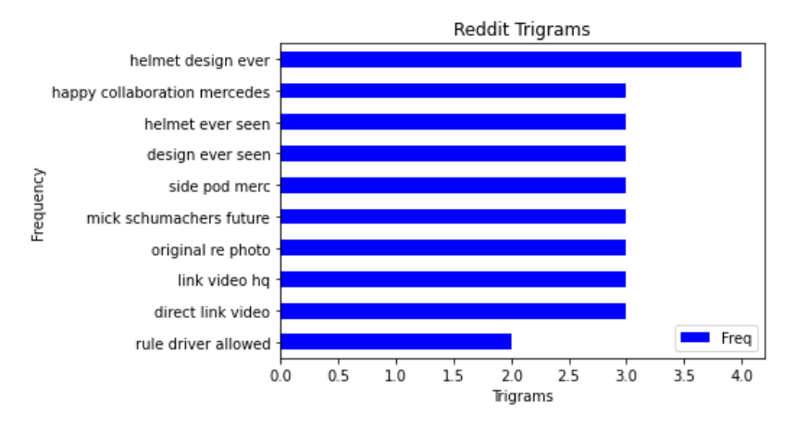
N-GRAMS VISUALIZATION FOR REDDIT
n=2 n=3

Slide 19
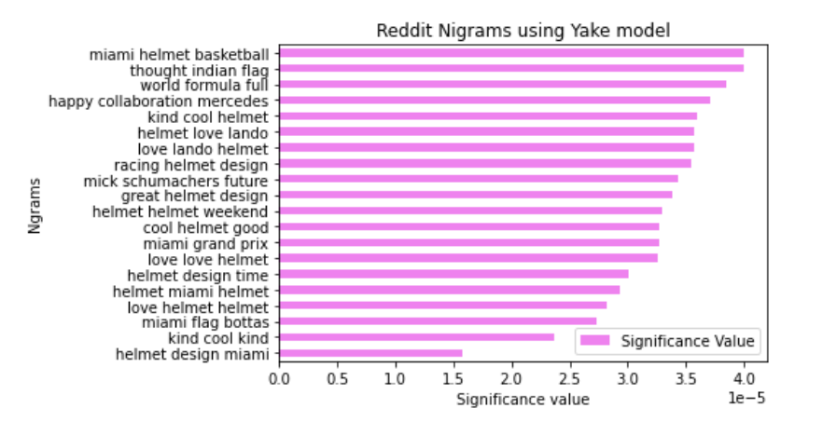
REDDIT N-GRAMS USING YAKE MODEL

Slide 20
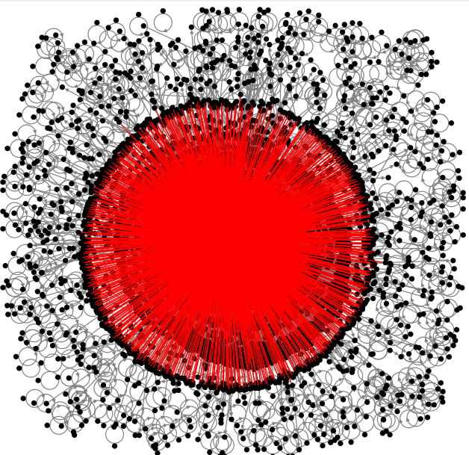
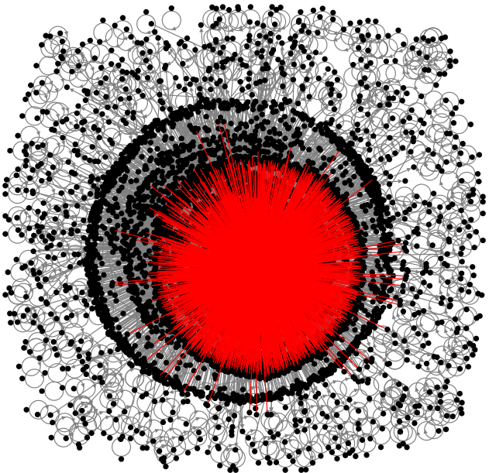

Top 3 Influential Nodes
@AstonMartinF1
@Hulkhulkenberg
@lance_stroll
Notes:
In addition to formula 1 as a search string,we also wanted to understand/capture the behaviour patterns and tone of conversation taking a particular team into consideration. We chose the team Aston Martin for this purpose.
After computing the

Slide 21
Aston Martin Network Metrics:
Nodes/Accounts | In-Degree | Betweenness Centrality | Closeness Centrality
@AstonMartinF1 | 3708 | 18892148.53 | 0.666
@Hulkhulkenberg | 2504 | 6962487.64 | 0.550
@lance_stroll | 1725 | 4106544.56 | 0.499
Notes:
Explain the significance and relevance of the metrics to the nodes:
Betweenness significance: Sorts people/nodes who have the quality of most broadly connecting across the network to the top. These are the most central and arguably the most influential people in the network. These users have a strategic location within the network created by the pattern of connections.
In-degree: These nodes have the most amount of tweets directed towards them in comparison to the out-degree which is very low.
Closeness Centrality: Indicates how close a node is to all other nodes in the network. Alternatively, average shortest path length from the node to every in the network.

Slide 22
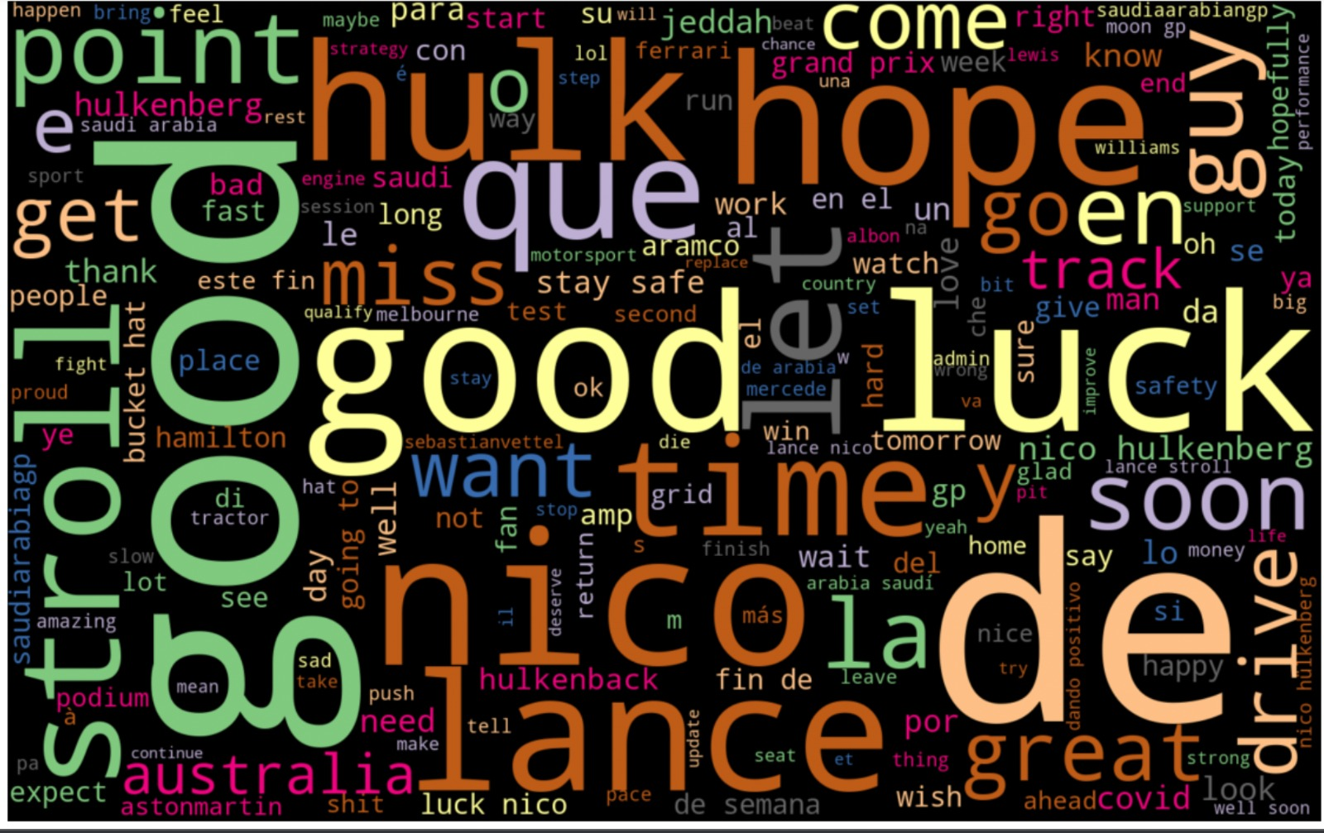
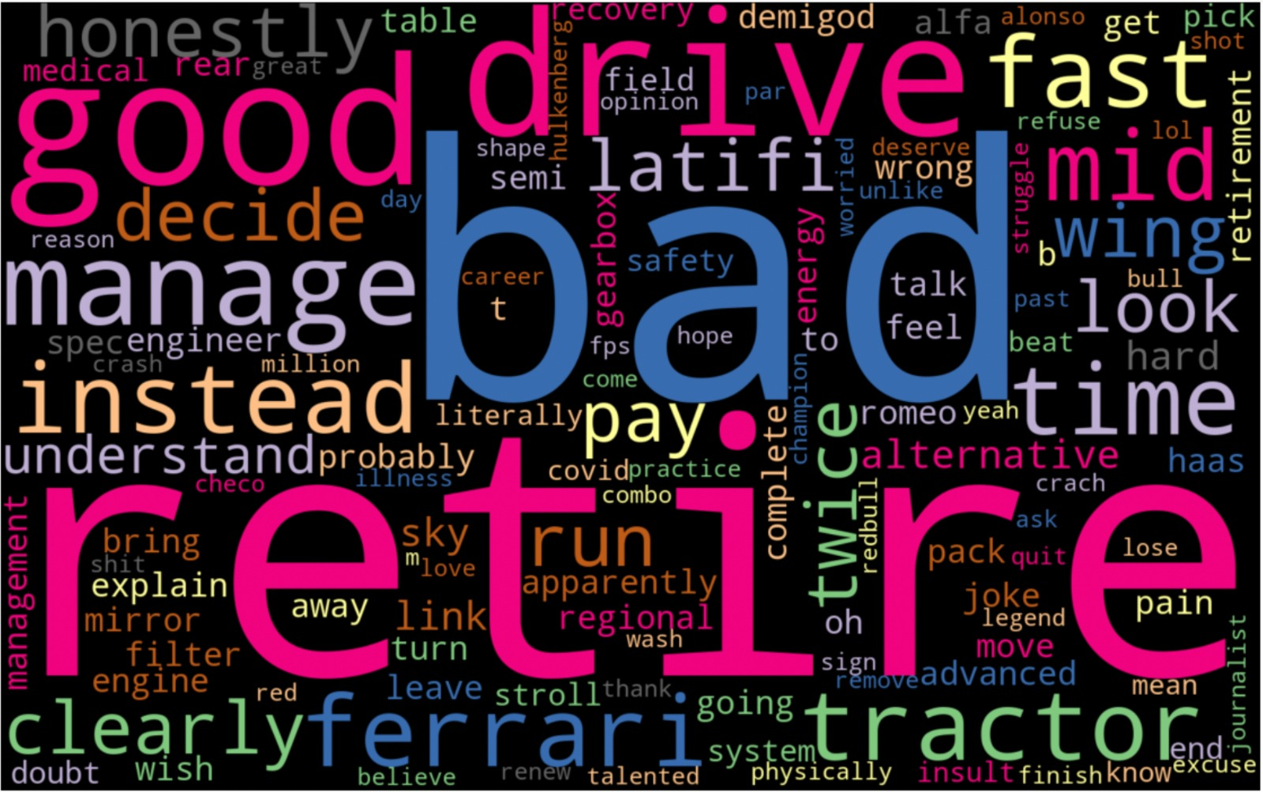
Twitter word-cloud:
Aston Martin F1
Reddit word-cloud:

Slide 23
Aston Martin word-cloud inference
Users on Twitter express positive sentiment/follow the sentiment as per the original post
Reddit users voice their unfiltered opinions and we can trace the apparent disappointment.

Slide 24
Conclusion:
Each platform attracts different demographic based on privacy features offered to its users
Formula 1 as an organization can use both platforms for specific surveying and commercialization purposes
Twitter could be used by participating brands to improve brand visibility
Reddit could be used as a platform to conduct surveys to gauge true unbiased opinions of individuals brought in by the anonymity feature.

